Slide 1
Topic: CI for Static Website
Automate Build & Validation for Static Website
Name: Tarun Swami
Group: 11

Slide 2
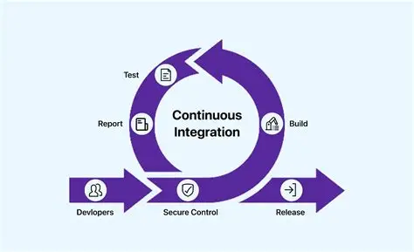
Introduction
Continuous Integration (CI) is a DevOps practice where code changes are automatically checked whenever new code is pushed.
This project uses GitHub Actions to automate validation for a static website.

Slide 3
Problem Statement
Manual validation of static websites can cause:
• Syntax errors
• Broken structure
• Faulty deployments
Automation is required to ensure reliability.

Slide 4
Objectives
• Create a GitHub repository
• Add a static website
• Configure GitHub Actions
• Validate code on every commit by git cmnds
• Implement CI pipeline

Slide 5
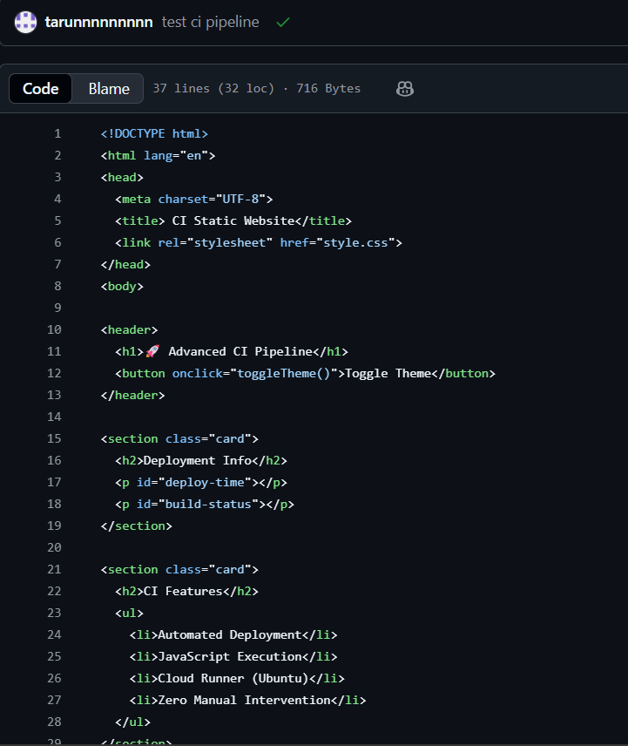
Static Website Overview
A static website serves fixed content.
Technologies used:
• HTML – Structure
• CSS – Styling
• JavaScript – Client-side logic

Slide 6
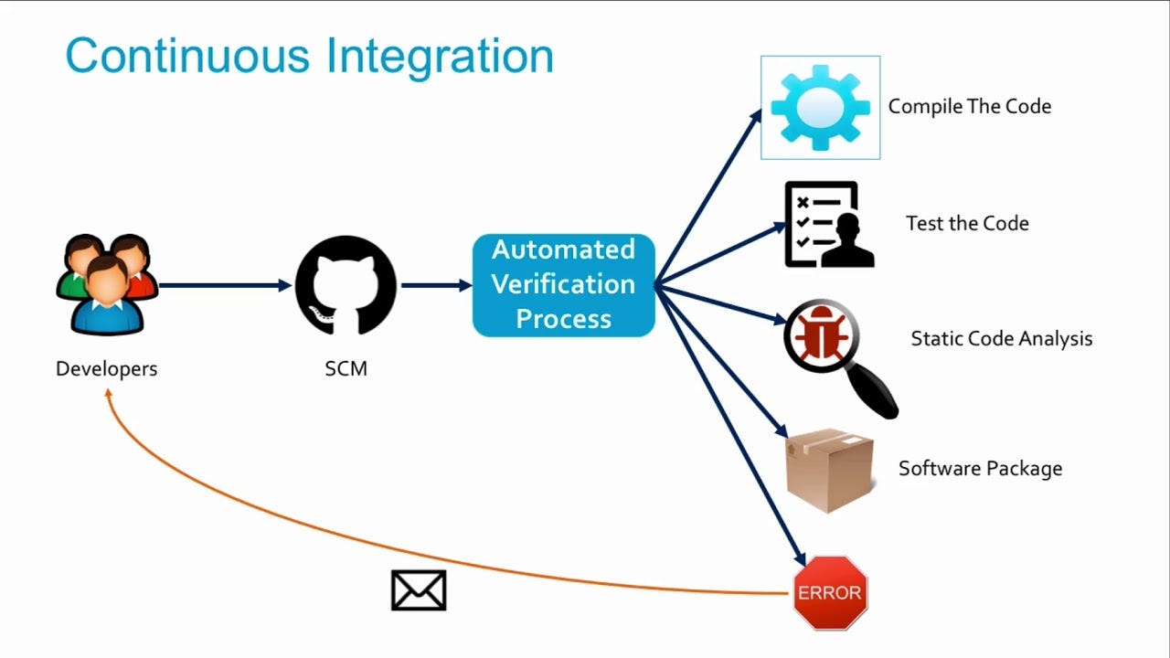
What is Continuous Integration (CI)?
CI automatically builds and validates code.
Benefits:
• Early error detection
• Better code quality
• Reduced manual effort

Slide 7
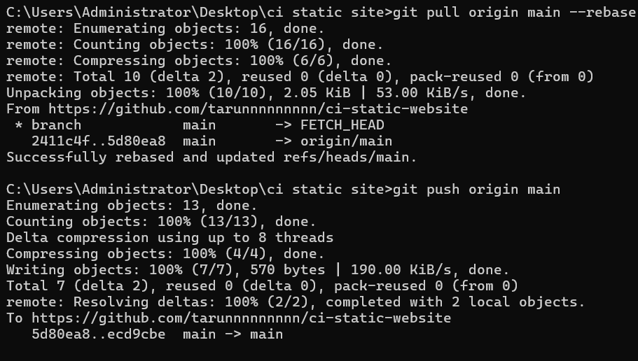
Tools & Technologies Used
• Git – Version control
• GitHub – Repository hosting
• GitHub Actions – CI automation
• HTML, CSS, JavaScript
• YAML – Workflow configuration

Slide 8
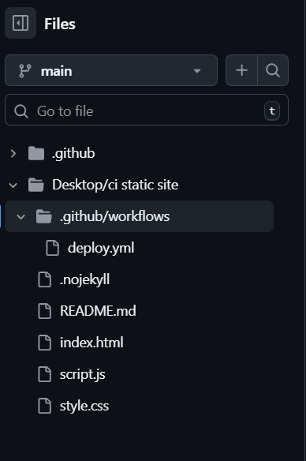
Project Structure
ci-static-website/
├── index.html
├── style.css
├── script.js
└── deploy.yml

Slide 9
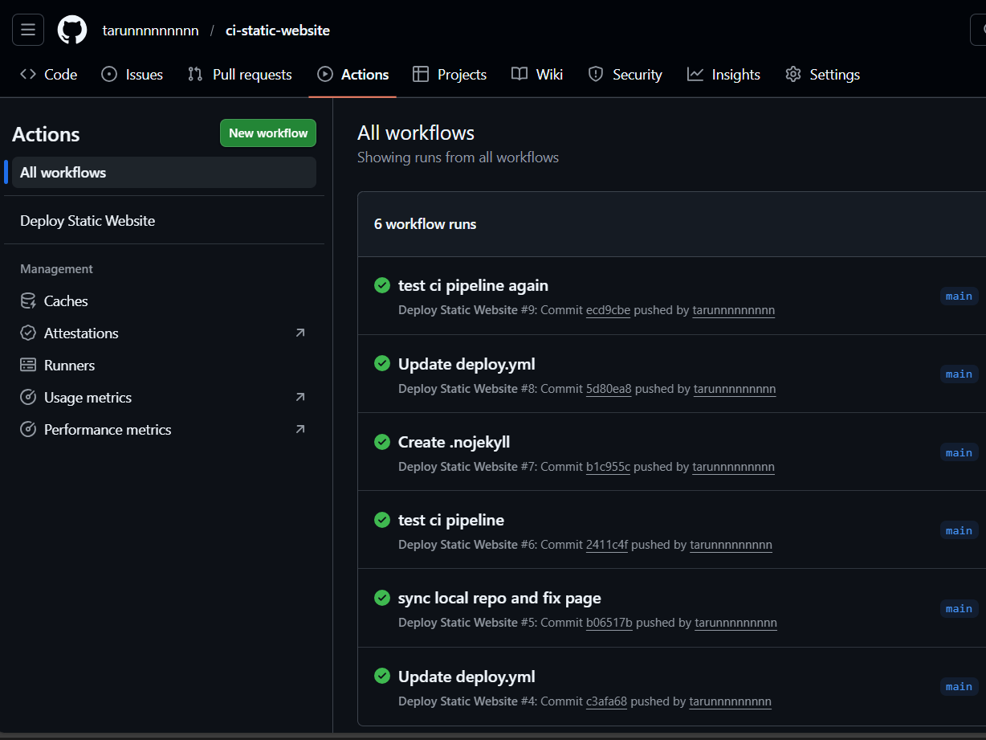
CI Workflow Using GitHub Actions
• Workflow triggers on push
• Code is checked out
• Website files are validated
• CI runs automatically

Slide 10
Output / Result
• CI runs on every commit
• Validation is automatic
• Workflow status visible in Actions
• Reliable website updates

Slide 11
Conclusion
This project demonstrates CI for a static website using GitHub Actions.
It improves reliability, automation, and follows modern DevOps practices.
It bridges the gap between academic learning and real-world DevOps automation.

